Slide 1

Propensity Model based on customers’ hotel booking behavior
Jigar Mehta
Feb 29th, 2016

Slide 2
Problem Statement
Identify customers who have a higher propensity to book hotel with a 10% coupon from a pool of customers
Conversion Rate = # Bookings / # Searches
Data Availability
Hotel searches and bookings data leading up to a Valentine’s Day check-in data (01Feb2015 to 13Feb2015)
1 text file : 56,274 records and 64 variables, Structured tabular data with “;” delimiter
Level of data – each record indicates distinct user session
Contains missing values
Outcomes of Analysis
Descriptive Analysis of hotel booking behavior
Inquisitive Analysis of Customer booking patterns and preferences
Customer Propensity Model – likelihood to book a hotel

Slide 3
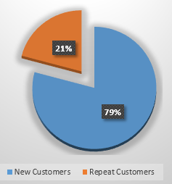
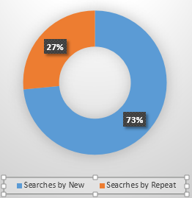
89% of Bookings are done by repeat customers
Generate
Generate
Customer Mix
Traffic Share
Bookings Share
Prospect Count
New: 34k; Repeat: 9k
Searches Per Repeat Customer: 1.67
Searches Per New Customer : 1.21
Total Bookings: 4,317
Booking Share is not same as Conversion Rate

Slide 4
How a Drop-Out is different from a Customer?
For Repeat Customer : 26 %
For New Customer : 1 %
Overall Conversion Rate : 7.67%
Repeat Customer : 12 +
New Customer : 1
Bookings : 13 +
Drop Outs : 155
Avg. Website Visits per hour : 168
Repeat Customer : 33 +
New Customer : 122
Booking Customers: 1
Drop Outs: 1.25
Avg. #Searches per visit: 1.27
Median AdvSearch Period : 4 days
Repeat Customer : 3 days
New Customer : 8 days
Same behavior for Booking and Drop-Out
Avg. Revenue Generated: 193
Repeat Customer : $ 190
New Customer : $ 210

Slide 5
No Pearson Correlation between Conversion Rate and Traffic, Session Time and Time to Event
Opportunity to maximize Revenue
Opportunity to maximize Profitability
Conversion Rate vs Traffic
Conversion Rate vs Session Time

Slide 6
Hypothesis: Whom Should be Targeted to Increase Conversion Rate ?
H1: Sending coupons to people who dropped out (only) will motivate them to become customer
H2: Sending coupons to people who booked in past (only) will motivate them to book again
H3: Sending coupons to both H1 and H2
Why not send coupons to all past Customers and to all Drop-Outs?
Constraints:
Per prospect Marketing Cost to send coupon
Budget – Is there an upper limit on number of coupons to send?
Budget – Is there an upper limit on revenue loss due to 10% discount

Slide 7
Recommendation
Send coupons to 50% of total Prospect-Base (Repeat Customers, First-time Customers and Drop-Outs)
Send Coupons to All Customers who purchased in past - Repeat customers and First-time Customers
Repeat customer has higher conversion (26%); will further increase conversion
Send Coupons to Selective Drop-Outs
~80% Traffic is by First-Time Buyers; Conversion Rate is just 1%
Increases stickiness of customers; encourages more purchases in the future
Increases Share-of-Wallet (SOW) and Customer Loyalty
Increases Customer Engagement and Positive Word-of-Mouth
Grab the Big Revenue Loss Opportunity – Increasing the Conversion Rate by just 5%-10% is Big Revenue
Increases Customer Engagement and Encourages Positive Word-of-Mouth

Slide 8

Recommendation Engine with Revenue Numbers
Assumption:
Marketing Cost to send coupon per customer is = 30 cents

Slide 9
Sensitivity Analysis – Simulation of % Drop-Outs to whom Coupons Sent vs Conversion Rate, on Revenue
% Customers Coupons Sent | Conversion Rate | # Customers | Total Revenue -10 % Coupon - Marketing Cost of Coupon
10% | 20.0% | 674 | $ 126,375
20% | 16.0% | 1078 | $ 201,796
30% | 12.0% | 1213 | $ 226,262
40% | 10.0% | 1348 | $ 250,728
50% | 8.5% | 1432 | $ 265,640
60% | 7.2% | 1456 | $ 269,088
70% | 6.3% | 1486 | $ 273,809
80% | 5.6% | 1510 | $ 277,257
%Drop-Out to whom Coupons are sent
There is a Non-Linear Relationship between % coupons marketed, Conversion rate and Revenue
which can be solved using optimization algorithm with constraints
Figures only Based on Drop-Outs

Slide 10
How to Identify the Selective Drop-Outs?
Profile and Behavior based Selection
Match the profile and behavior of current Customers with High PCV score and RFM score on Drop-Outs
Build a Propensity Statistical Model
Probabilistic and/or Pure Classifier with higher probability indicating higher chance to book
Note:
PCV is Past Customer Value – used to identify profitable and loyal customers
RFM is Recency, Frequency and Monetary based customer ranking to identify profitable and loyal customer
Better Metric is CLV – Customer Lifetime Value

Slide 11
Behavioral Segmentation and Customer Profiling
ButterFlies
Affluents
Increase Stickiness
Cross-Sell
Migrate to Affluent
Up-Sell & Cross-Sell
Prevent Churn
Engage More
#Website Visits Per Hour | 0.5
#Searches Per Visit | 1.0
Median Srch Ap | 8.0
Avg. Srch Los | 1.8
Avg. Dist Srch Origin To Dest | 749.2
Avg. Gr Book Amt | 389.9
Avg. Htl Review Count | 667.9
Median session time | 7.9
Traffic (Searches) | 160
#Website Visits Per Hour | 3.4
#Searches Per Visit | 1.0
Median Srch Ap | 4.0
Avg. Srch Los | 1.8
Avg. Dist Srch Origin To Dest | 659.9
Avg. Gr Book Amt | 366.1
Avg. Htl Review Count | 573.0
Median session time | 2.9
Traffic (Searches) | 1159
High Spenders
#Website Visits Per Hour | 0.9
#Searches Per Visit | 1.0
Median Srch Ap | 8.0
Avg. Srch Los | 1.1
Avg. Dist Srch Origin To Dest | 518.3
Avg. Gr Book Amt | 118.2
Avg. Htl Review Count | 314.0
Median session time | 3.2
Traffic (Searches) | 317
#Website Visits Per Hour | 8.0
#Searches Per Visit | 1.0
Median Srch Ap | 3.0
Avg. Srch Los | 1.1
Avg. Dist Srch Origin To Dest | 497.6
Avg. Gr Book Amt | 114.6
Avg. Htl Review Count | 277.6
Median session time | 2.7
Traffic (Searches) | 2681
Low Spenders
Increase Share-of Wallet
Up-Sell and Cross-Sell
Migrate to Affluent
Increase Stickiness
Cross-Sell
Increase SOW
Migrate to Affluent
Strangers
Barnacles
New Customer
Repeat Customer

Slide 12
Propensity Model to Identify Customers
Predictors : Websites visits per hour, Searches per visit, Search Advance period, Search LOS, Search from Top States by revenue (1,2,3 and other), Destination in Top States (1,2,3 and other), Day of week * Shift of a day, # devices used, session time, Buy %, User_type (Repeat or New), Distance from Origin to Destination.
Dependent : Booking Flag (Yes or No)
Dataset : 43K total unique customers, 13 variables( 12 Predictor + 1 Dependent)
Data Partition : Multiple Iterations - 70:30, 75:25, 80:20
Algorithm used: Logistic Regression, Neural Network, SVM - Supervised Machine Learning
Problem Type: Classification Problem

Slide 13
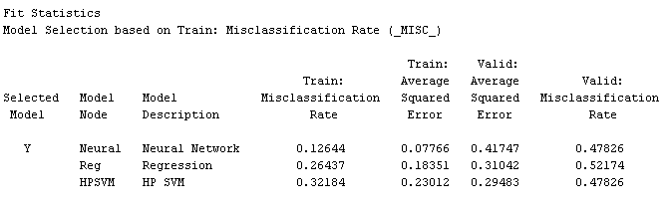
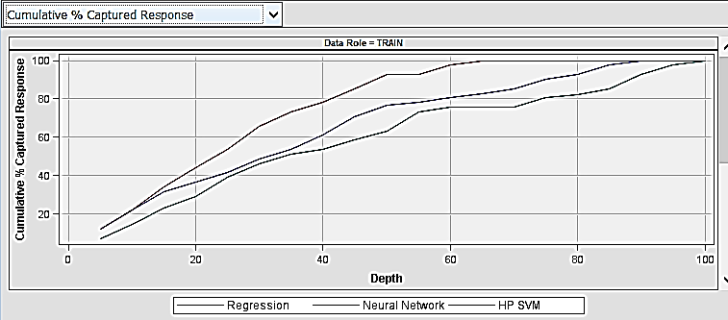
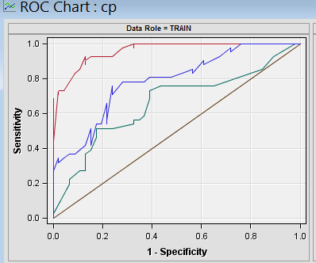
Model Output and Comparison (Neural Network, Logistic Regression, SVM)
Neural Network performs better than Logistic and SVM on training; but poorly on validation. But, Logistic Regression performs better on Validation. Hence, we select Logistic.
Model Comparison
Cumulative Captured Response
ROC Curve
Model | Precision | Recall
Neural Network | 85.7% | 87.8%
Logistic Regression | 72.5% | 70.7%
SVM | 72.4% | 51.2%
Neural Net
SVM
Logistic
Lift
Precision = tp/(tp+ fp)
Recall = tp/(tp+ fn)

Slide 14
Behavioral Analysis

Slide 15
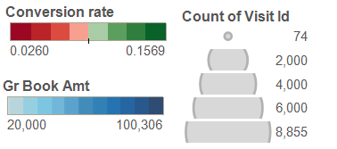
Comparing Traffic Origination in each State with Conversion Rate and Revenue
Low Conversion, High Traffic :
California
Florida
Arizona
New York
Massachusetts
High Conversion, Low Traffic :
North Carolina
Colorado
Illinois
Washington
Georgia, Michigan
High Revenue States:
California
New York
Illinois
Florida
Massachusetts

Slide 16
Share of Revenue for each Destination state by Repeat and New Customer; Background color shows Traffic

Slide 17

Conversion Rate is a function of (Searched) Day of Week and Time of Day

Slide 18
Repeat customers are driven by Hotels reviews

Slide 19

Missing Values Information Tools Used:
Logical column # | Variable | Percent.Missing
62 | DIST_CUST_IP_TO_BILLING | 92.6
63 | DIST_BILLING_TO_DEST | 92.6
64 | DIST_BILLING_TO_HTL | 92.6
36 | TRANSACTION_ID | 92.3
40 | OFFER_HOUR | 92.3
44 | BK_LOS | 92.3
45 | BK_AP | 92.3
46 | GR_ORDERS | 92.3
47 | GR_ROOM_NIGHTS | 92.3
48 | GR_BOOK_AMT | 92.3
49 | BK_DEST_CITY_ID | 92.3
54 | BK_DEST_LAT | 92.3
55 | BK_DEST_LON | 92.3
56 | HOTEL_ID | 92.3
57 | HTL_STAR_RATING | 92.3
58 | HTL_REVIEW_COUNT | 92.3
59 | HTL_REVIEW_SCORE | 92.3
60 | DIST_CUST_IP_TO_DEST | 92.3
61 | DIST_CUST_IP_TO_HTL | 92.3
4 | EMAIL_KEY | 73.5
SAS, Tableau, R, Python, Excel and PowerPoint
Challenges:
Time for Project
Data Understanding
Business Constraints
Lack of Business Clarity

